Slide 1
Dinner Diner
By: Stefano, Max, Tomas and Justin

Slide 2
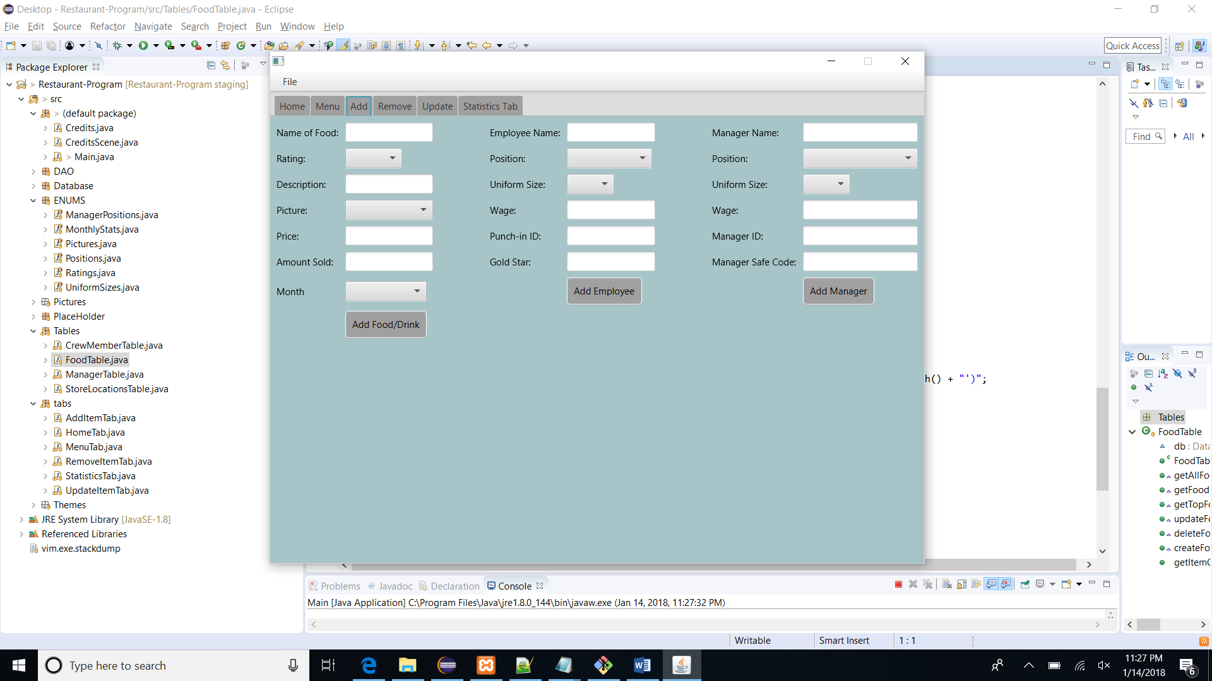
The Problem We Were Tasked With
We were asked to create software that could keep track of something.
It needed to implement GUI(Buttons, tabs, textBoxes, etc) a database to hold whatever we implement
Knowing this, we created something we are all proud to of: our Restaurant Program.

Slide 3
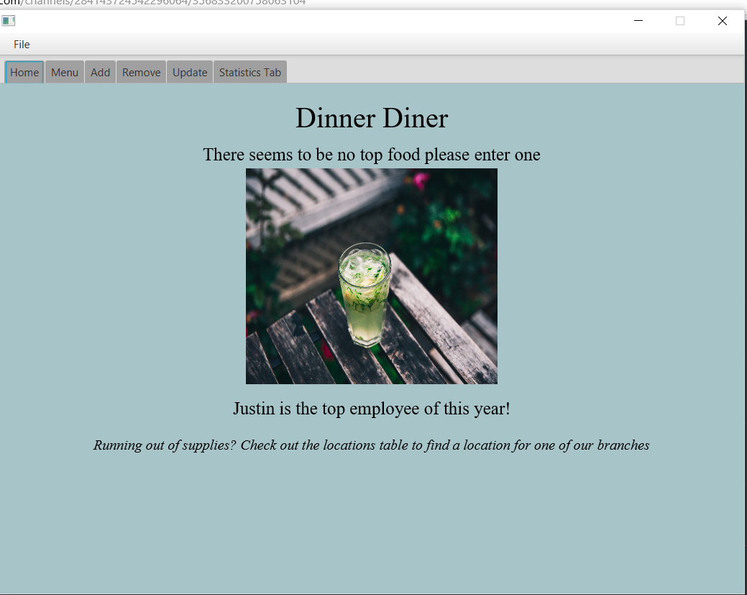
The Program That We Created
Our goal was to create an app to help a manager better organize their business and help making their lives easier.
It is used by managers to remove, update and add employees or different food items to a database.
We wanted to make the program as reusable as possible because this is a app that can be used for any sales company.

Slide 4
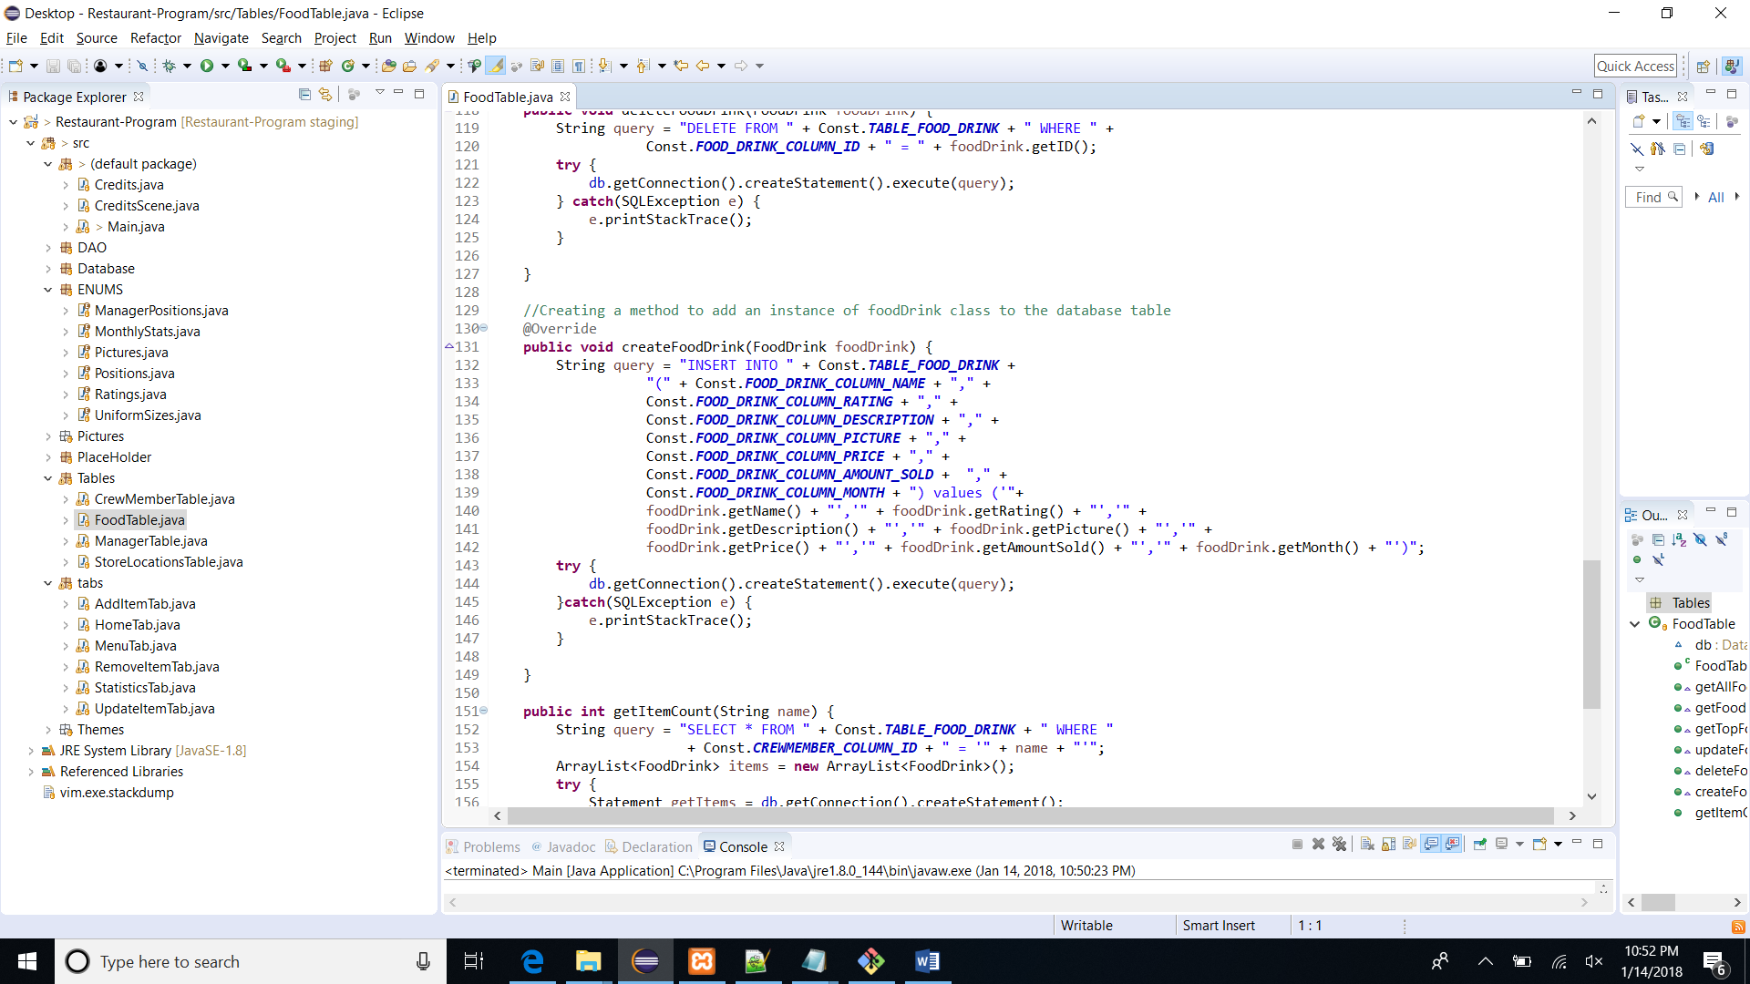
How long did it take?
Each individual working on the project worked over 20 hours each.
What took a lot of time was the update query.
Each group member took roughly 1 hour to set up the database using XAMPP, we used this program because we were unable to actually test the code.
Since we’ve only started using GitHub this year each, group member spent a bit of time troubleshooting their errors with git.

Slide 5
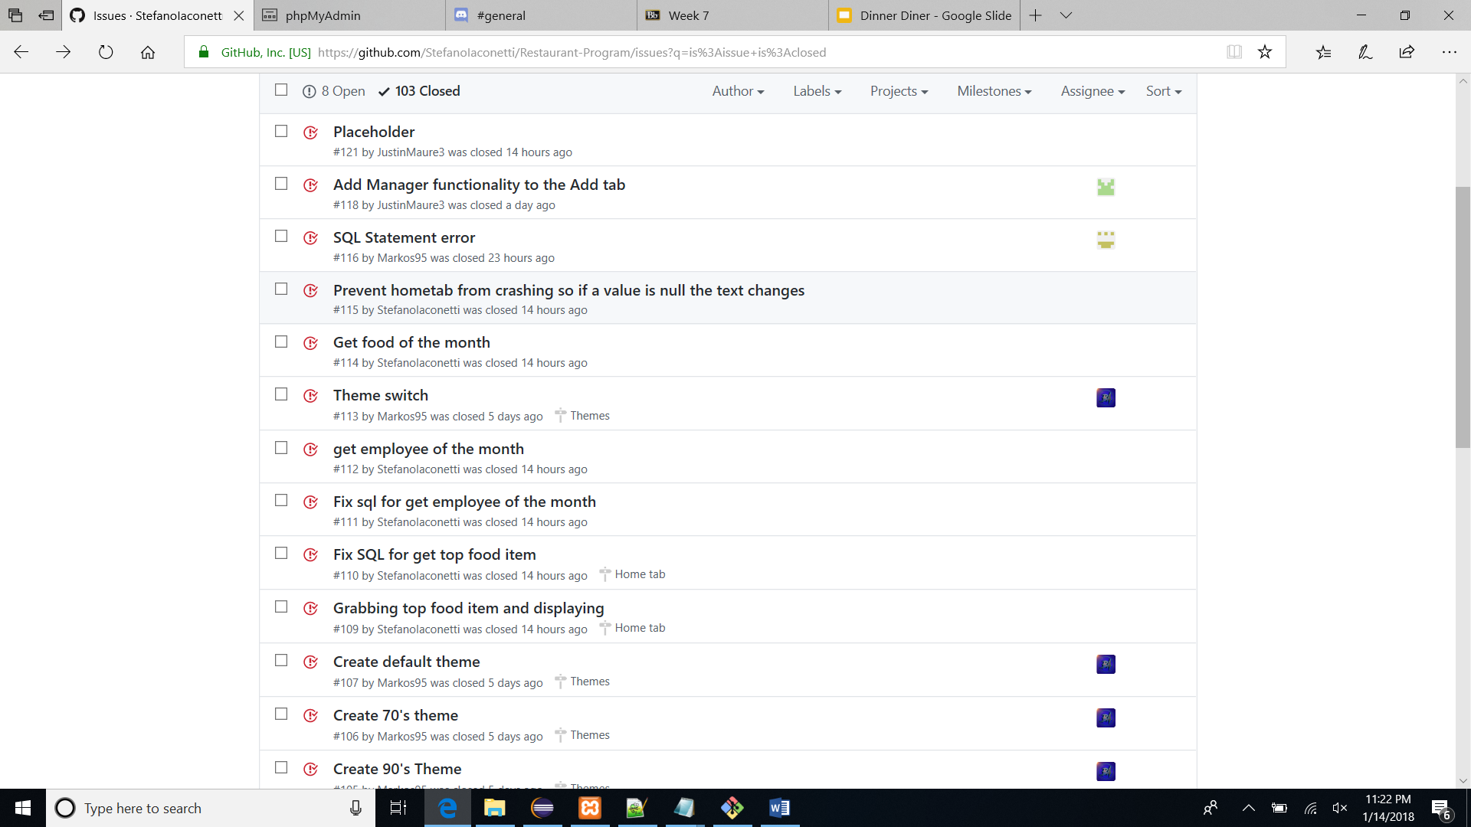
How we went about building the app
Most tasks didn’t take too long to complete
The database was a real time consumer
We split up the tasks between everyone.
Justin - Manipulating the tables
Stefano - Creating databases
Max - Displaying content
Tomas - Creating themes
Communication played a major role in our project.

Slide 6
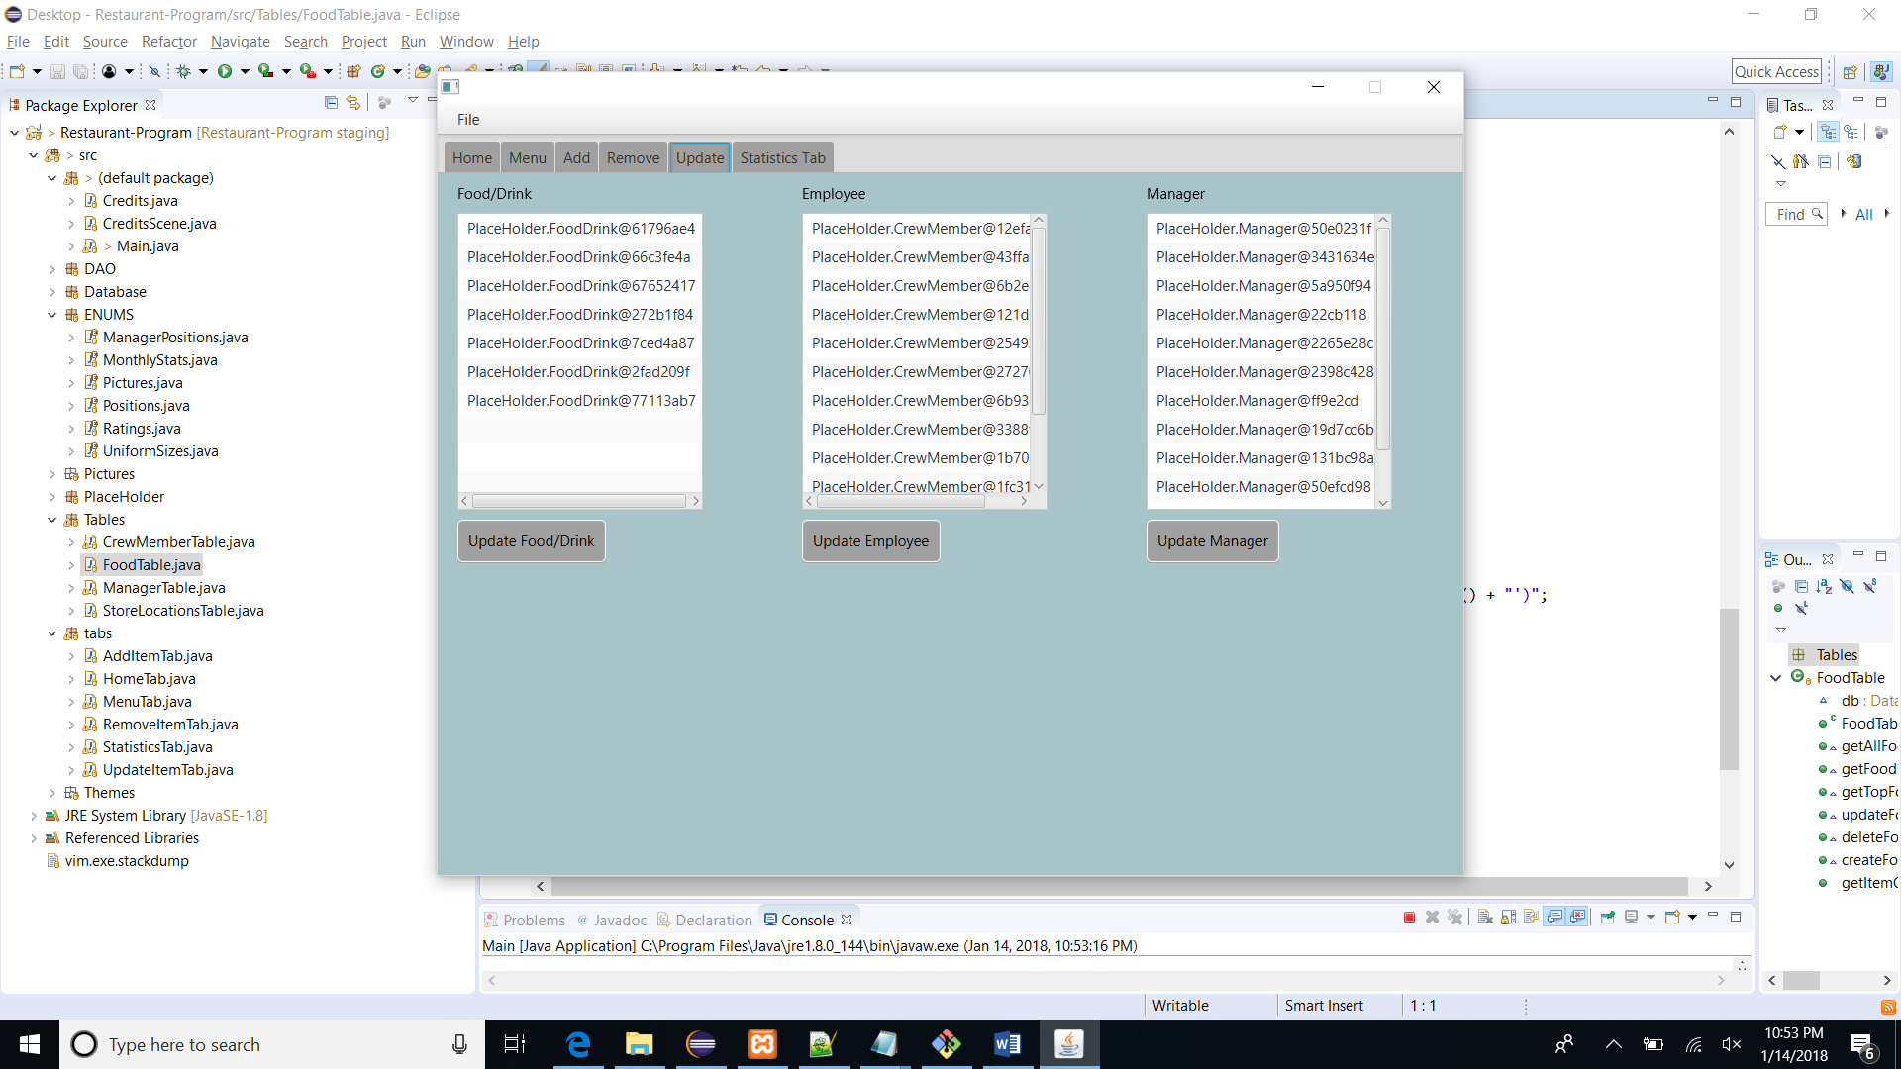
Issues that we overcame
Database
Only being able to access the server while being connected to the school’s network made testing difficult.
SQL Query
We had finished the code for the query but it wouldn’t work. Turns out, we forgot two spaces and a quotation mark.
Graphs
Due to those issues, displaying graphs took quite a while since we needed the databases and the SQL query to get the information.

Slide 7
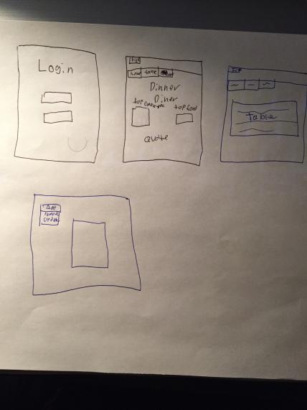
Did we end up making the app we wanted?
We believe that what we made was better than what we hoped
The software that we ended up with is very similar to what we planned on making
We originally planned only to have one table, but wanting to take the extra step we added employees and store locations
Our finished program incorporates more features than we planned on having
The restaurant owner can now manage their employees, as well as their performance.

Slide 8
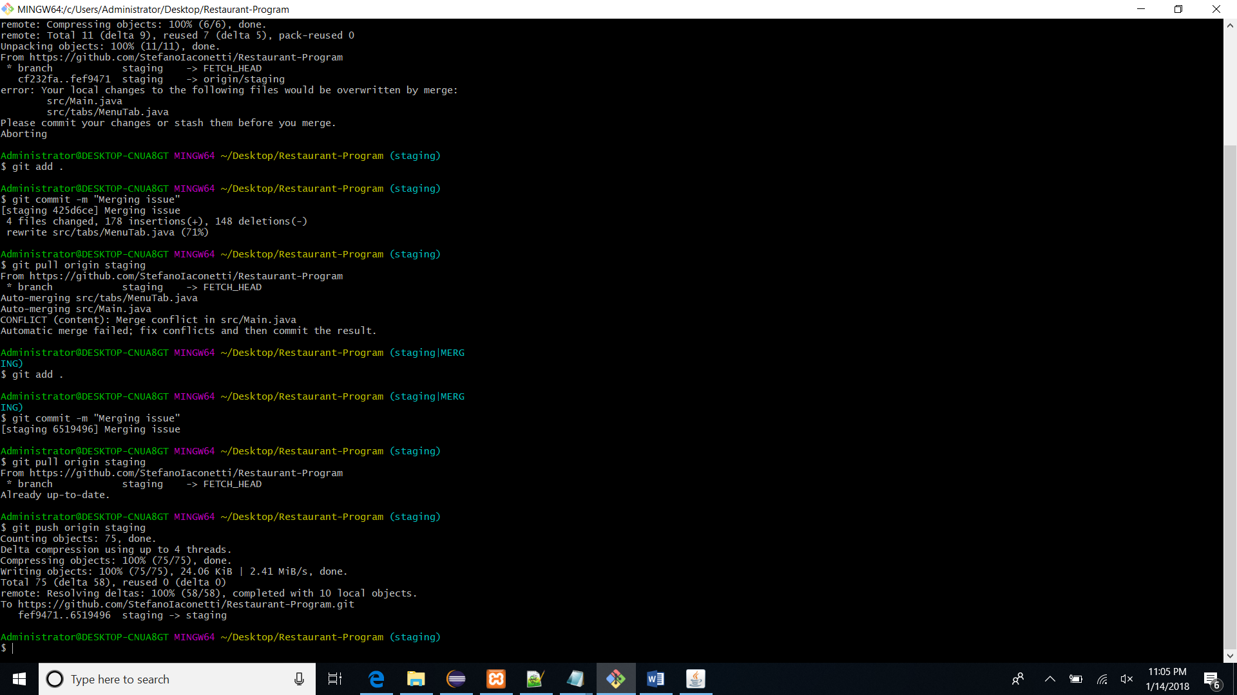
What technology did we use and why?
Eclipse was used for all of the coding
Xampp for hosting the database
Stock photo website used was “Burst”
GitHub to simplify group coding
Discord for easier communication
Stack overflow was used to help solve small issues

Slide 9
On to our program!

